Slide 1


DEPARTMENT OF INFORMATION TECHNOLOGY
V R SIDDHARTHA ENGINEERING COLLEGE
Avantel ImedsLife Project
Health Care Management System
Domain : Health Care
B.Tech in INFORMATION TECHNOLOGY
MINI Project Review Presentation
Presented by :
RIZWANULLAH MD ( 208W1A1299 )
SRI SASHANK P ( 208W1A12B3 )
Under the guidance of
M RAMESH Asst Prof

Slide 2
AGENDA
Problem Statement
Objectives
Outcomes
Literature review
Requirements of Project
Architecture Diagram
Implementation Steps
Current Working Module
Results
Implementation Links
References

Slide 3
PROBLEM STATEMENT
To develop a Web and Mobile application that offers healthcare services. This platform will cater to patients, doctors, pharmacists, and lab operators etc.

Slide 4
OBJECTIVES
PHASE-1:
Develop a web-based platform for the Health Care Management System.
Ensure the platform is user-friendly and intuitive for all user categories: patients, doctors, pharmacists, and lab operators.
PHASE-2:
Extend the platform by creating a mobile application version for better accessibility.
Optimize the mobile application for various screen sizes and devices.
PHASE-3:
Enhance security across both web and mobile platforms.
Address and rectify the top vulnerabilities to ensure robust security.
Implement TLS v1.2 for secure data transfer between the server and applications.
Introduce user registration and logging features.

Slide 5
OUTCOMES
A versatile platform available as both a Web application and Mobile apps for iOS & Android.
Users can seamlessly schedule and consult with doctors through text, voice, or video appointments.
Doctors can efficiently manage their patients, and keep track of them easily.
Patients have the convenience of booking lab tests and ordering prescribed medicines directly through the platform.
The system features electronic prescriptions, making it straightforward for pharmacists to dispense the correct medicines.

Slide 6
LITERATURE REVIEW
PROCTO | MY FAMILY DOCTOR | IMEDSLIFE PROJECT
Virtual Consultation Available | Virtual Consultation Available | Virtual Consultation Available
Online Lab Tests Booking Available. | No Online Lab Tests | Online Lab Tests Booking Available.
Specialized Practitioners | General Purpose Practitioners | Specialized Practitioners
Multiple Countries | Only In India | Only For Hospital Patients
Online pharmacy | No Online pharmacy | Online pharmacy
Pay Per Service | Subscription Model | Pay Per Service
No Health Packages | Health Packages Available | Health Packages Available

Slide 7






REQUIREMENTS OF PROJECT
FRONT END
BACK END

Slide 8







SOFTWARE REQUIREMENTS
OS
XCode
Android Studio
Windows
Kali Linux
MOBILE APP REQUIREMENTS
STORAGE
VSCode
React Native
AWS S3

Slide 9
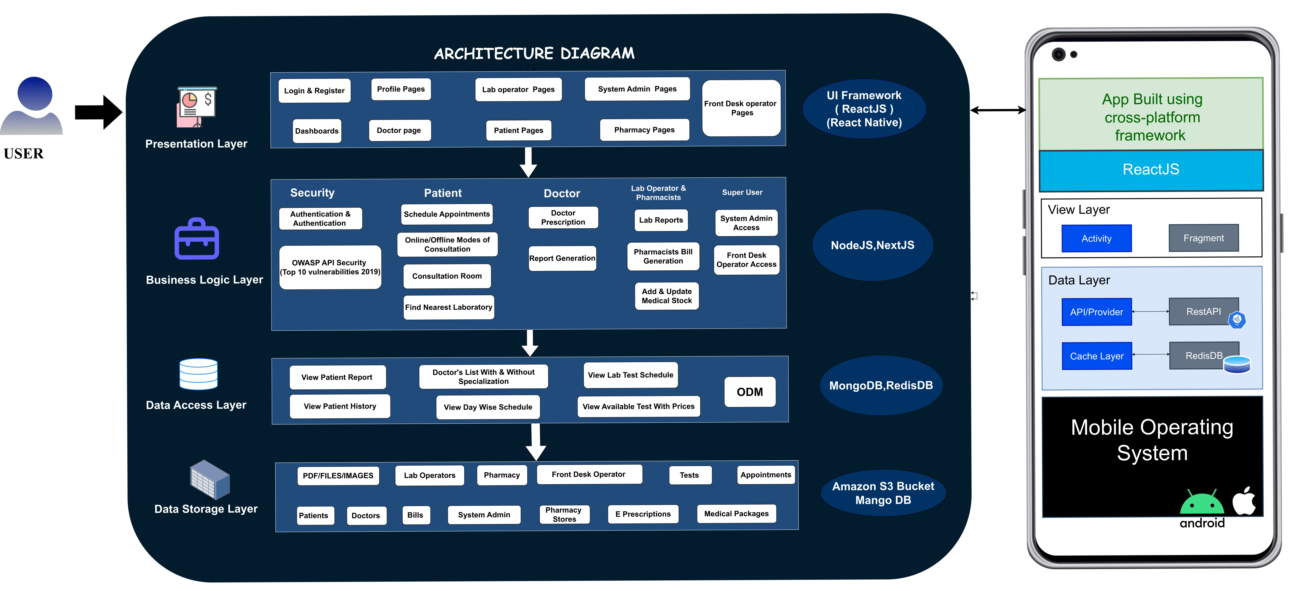
ARCHITECTURE DIAGRAM

Slide 10
IMPLEMENTATION STEPS
Web App Interfaces: Create pages for logging in and signing up. Separate registration for doctors, patients, system admins, and lab admins.
Dashboard Development: Make dashboards for doctors, patients, system admins, and lab admins. Allow users to choose a doctor based on their symptoms or can just directly proceed with the specialist they need.
Scheduling System: Users can book times to see doctors. Doctors can view their schedules on a calendar.
Consultation Methods: Options for users to text, video call, or voice call doctors.
Prescription System: Doctors can give e-prescriptions. Patients can view their health details and book lab tests.
System Features:Add safety measures. Set up user sign-ups and log-ins.

Slide 11
CURRENT WORKING MODULE
MODULE/FEATURE | DESCRIPTION
Current Working Module | Patient
Prescription | Showing Prescription to patient on request.
Login | Converting OTP for login to 6 digits
Dashboard | Developing special dashboard for patients with new features.
Functions | Manage appointments , Connect with the patients and Give E-Prescription for consultation.

Slide 12
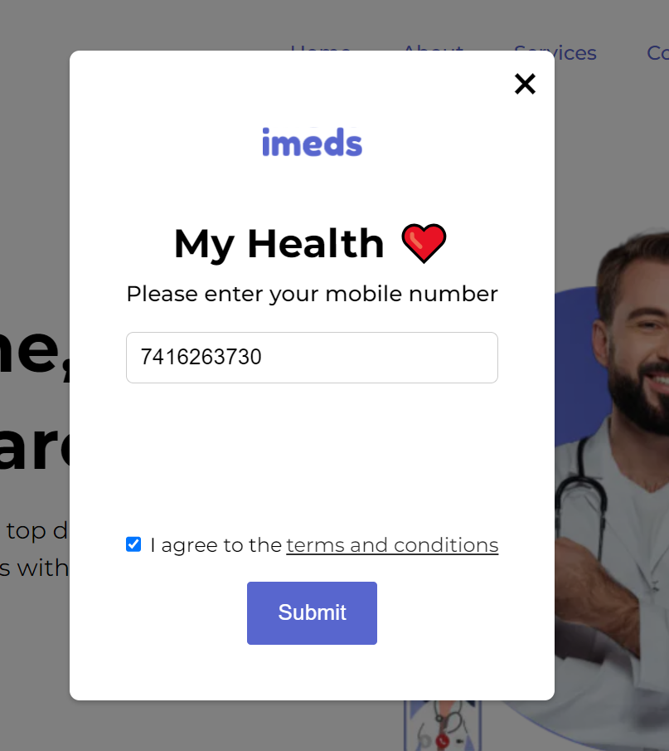
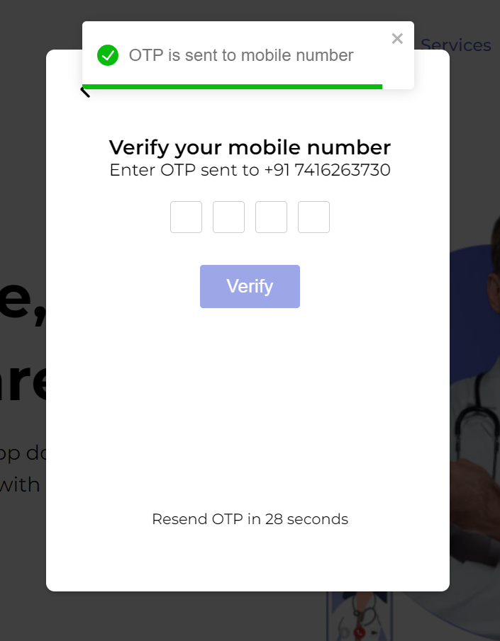
RESULTS OF PATIENT WEB

Slide 13
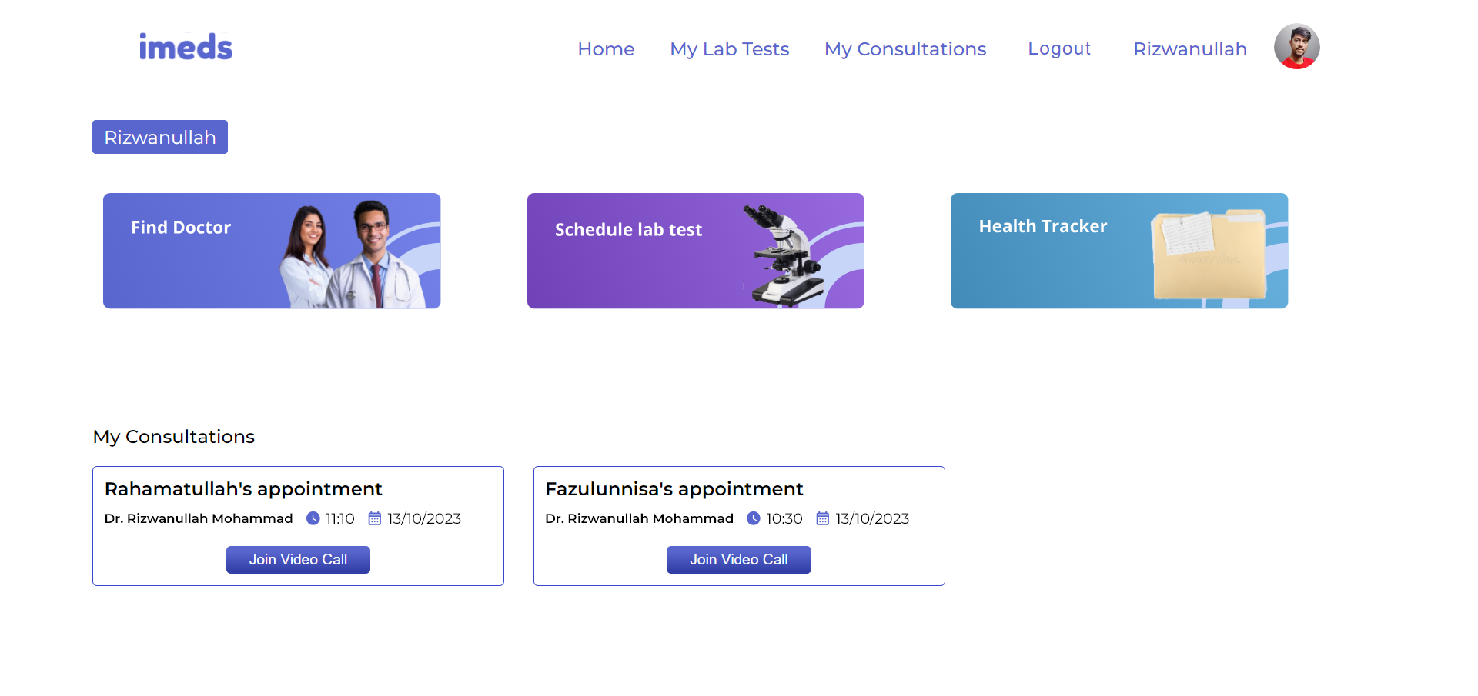
RESULTS OF PATIENT WEB

Slide 14
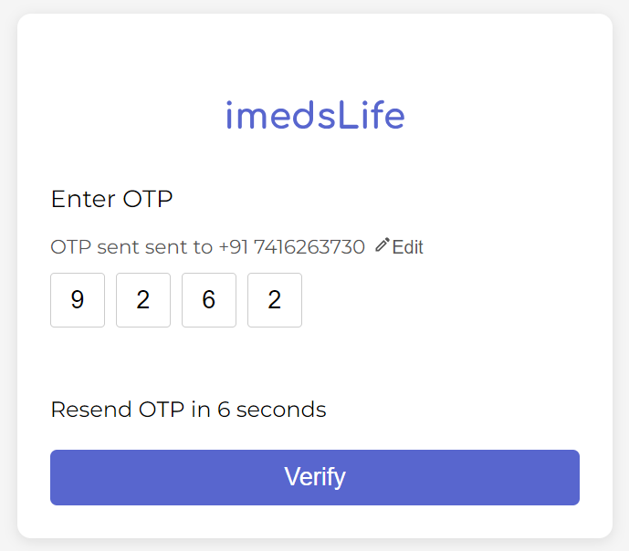
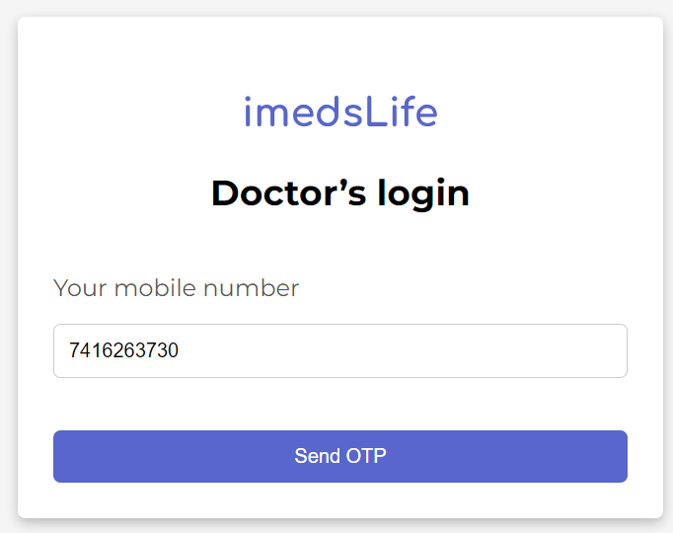
RESULTS OF DOCTOR WEB

Slide 15
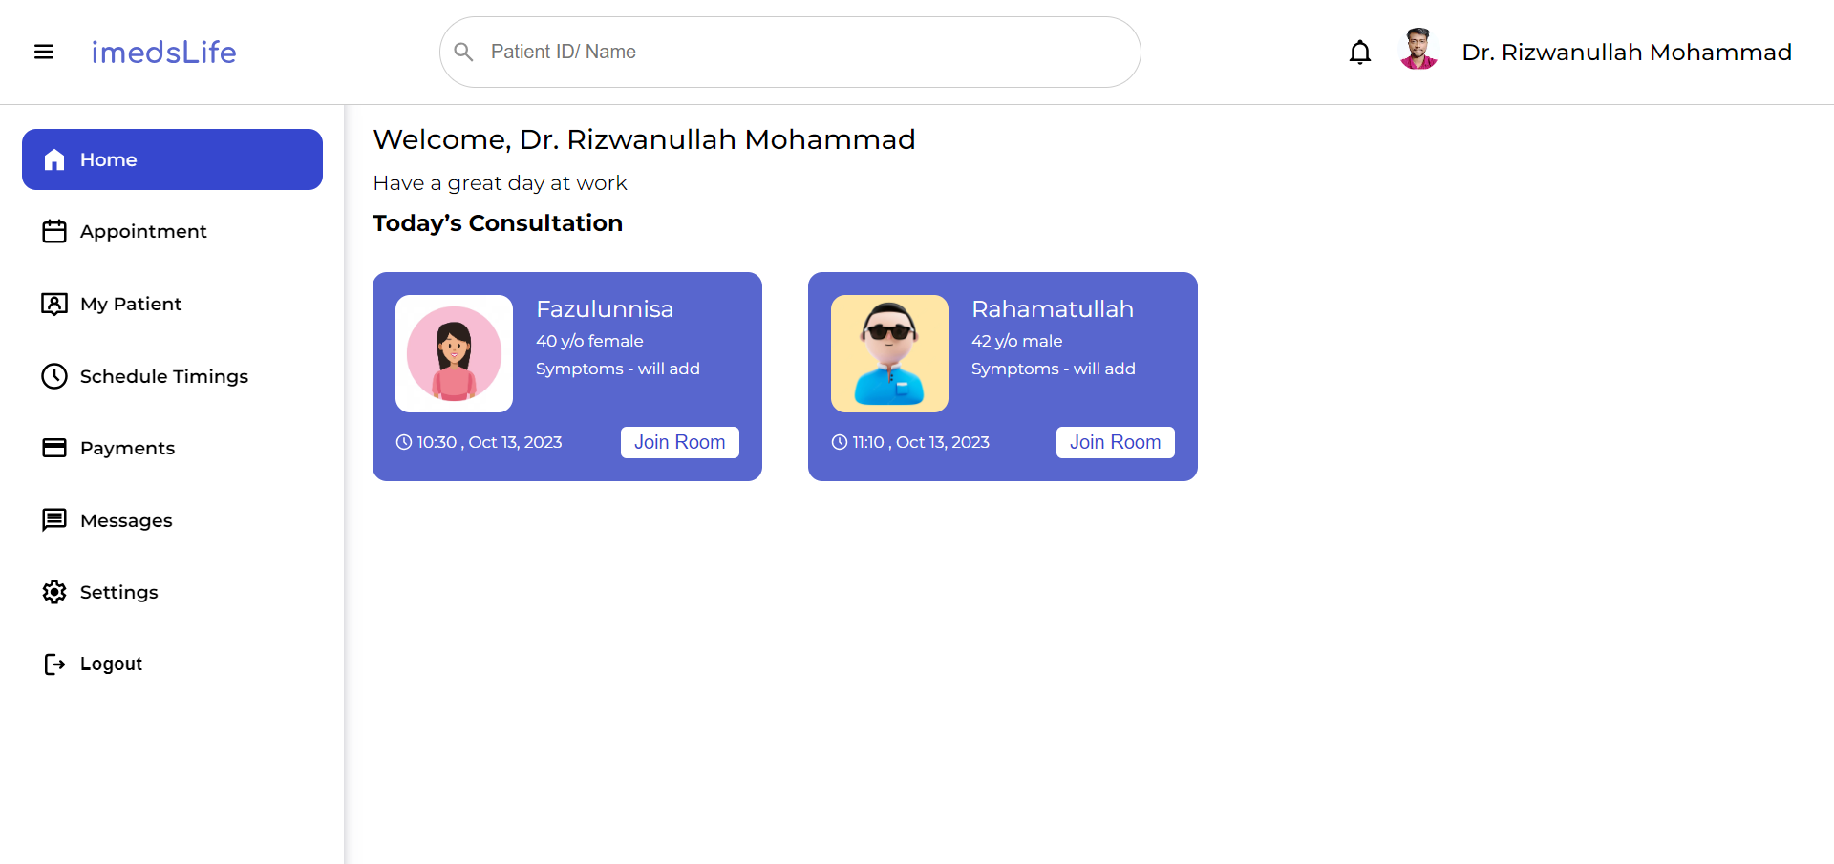
RESULTS OF DOCTOR WEB

Slide 16
IMPLEMENTATION LINKS
Patient Module Web : https://imedslife-patient.vercel.app/
Doctor Module Web : https://imedslife-doctor.vercel.app/

Slide 17
REFERENCES
[1] https://nextjs.org/
[2] https://react.dev/
[3] https://www.mongodb.com/
[4] https://www.practo.com/
[5] https://www.clickittech.com/devops/web-application-architecture/
[6] https://soft-builder.com/bank-management-system-database-model/

Slide 18
THANK YOU

